Slide 1
How A.I. Works
(in 60 minutes)

Slide 2
Where is my robot?

Slide 3
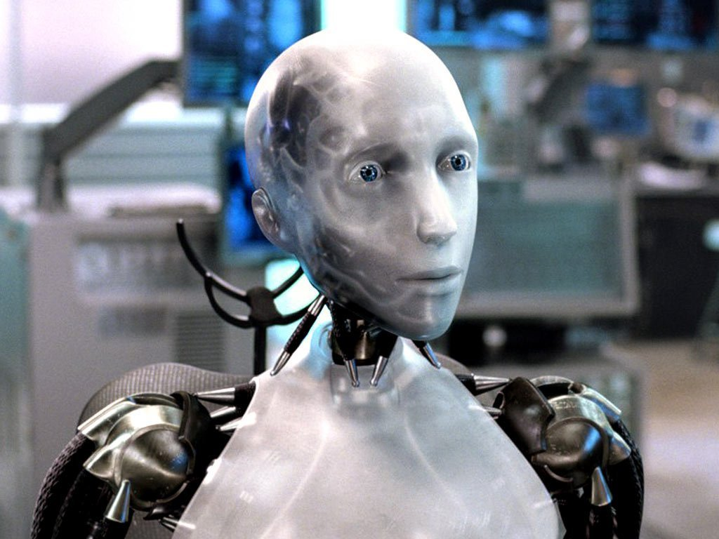
Sci-Fi Has Promised Me Robots

Slide 4
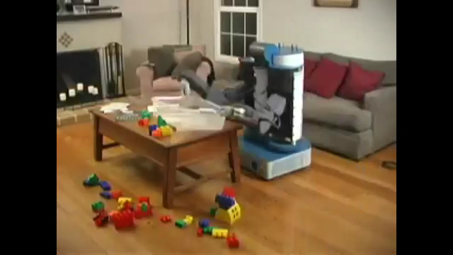
House Cleaning Robot

Slide 5
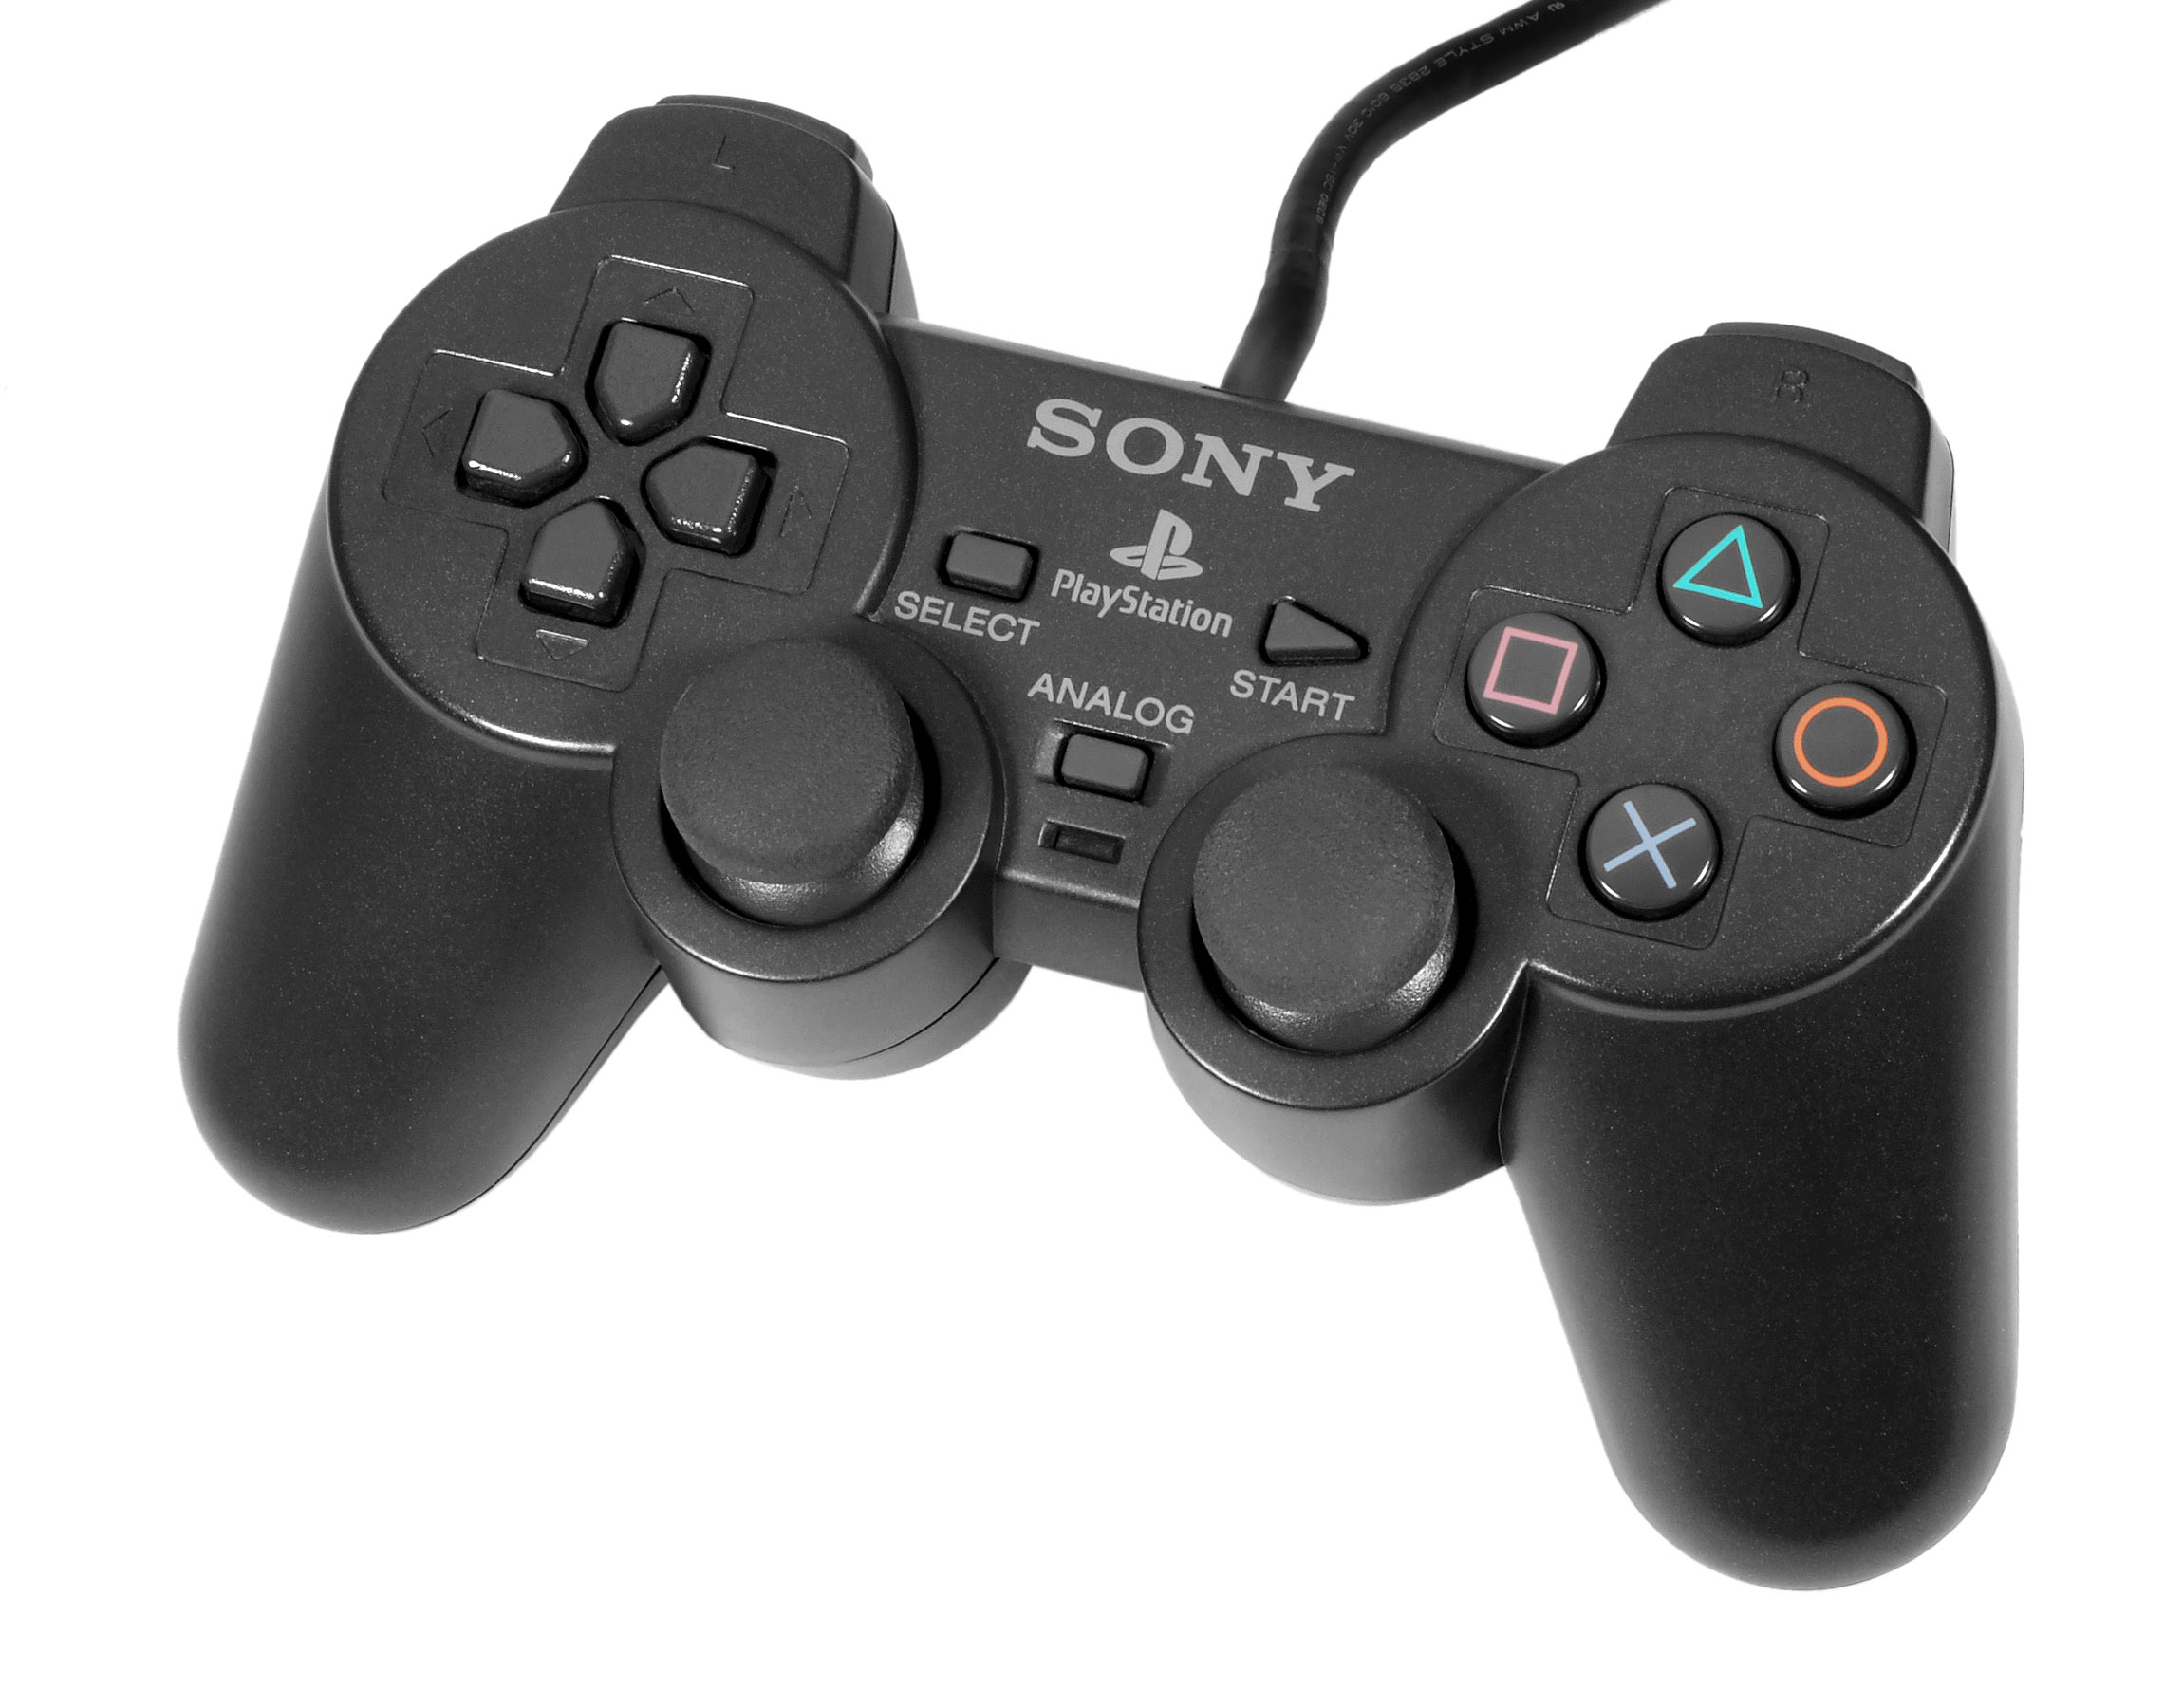
House Cleaning Robot

Slide 6
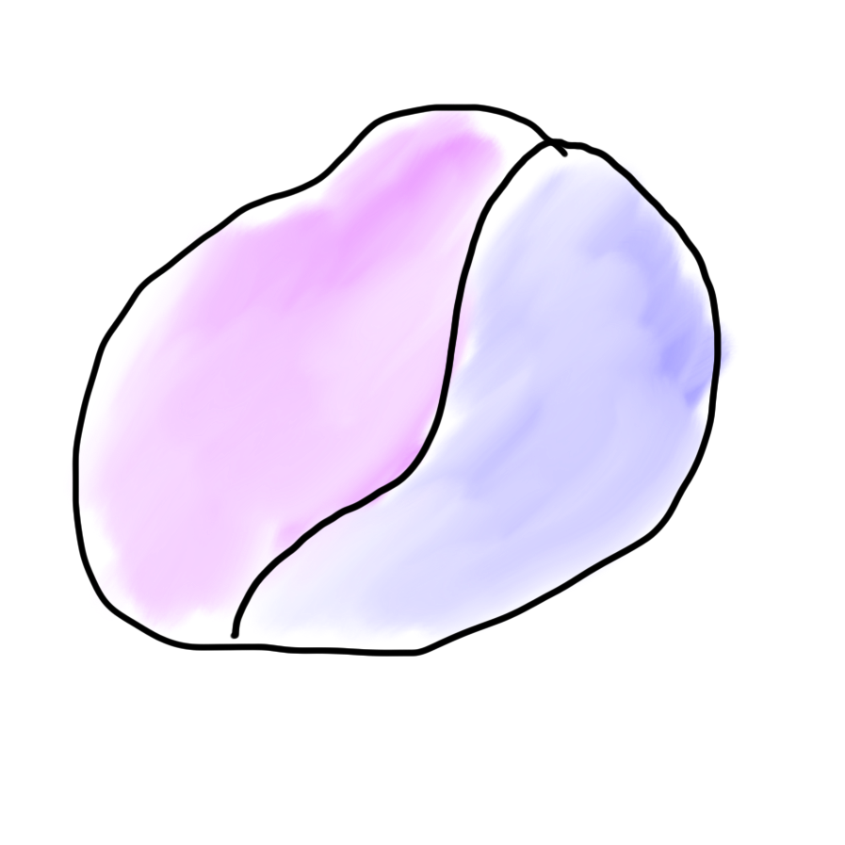
Robots?
Mind
Body

Slide 7

Robots?
Mind
Body

Slide 8
What is AI?

Slide 9
[suspense]

Slide 10
AI: The study and design of intelligent agents

Slide 11
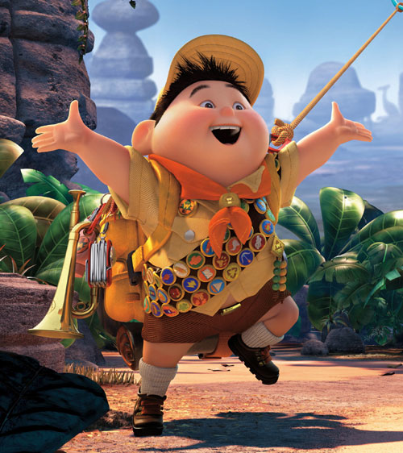
Volunteer

Slide 12
Computer
programs
AI: The study and design of intelligent agents
Better than
chance
As well as
humans

Slide 13
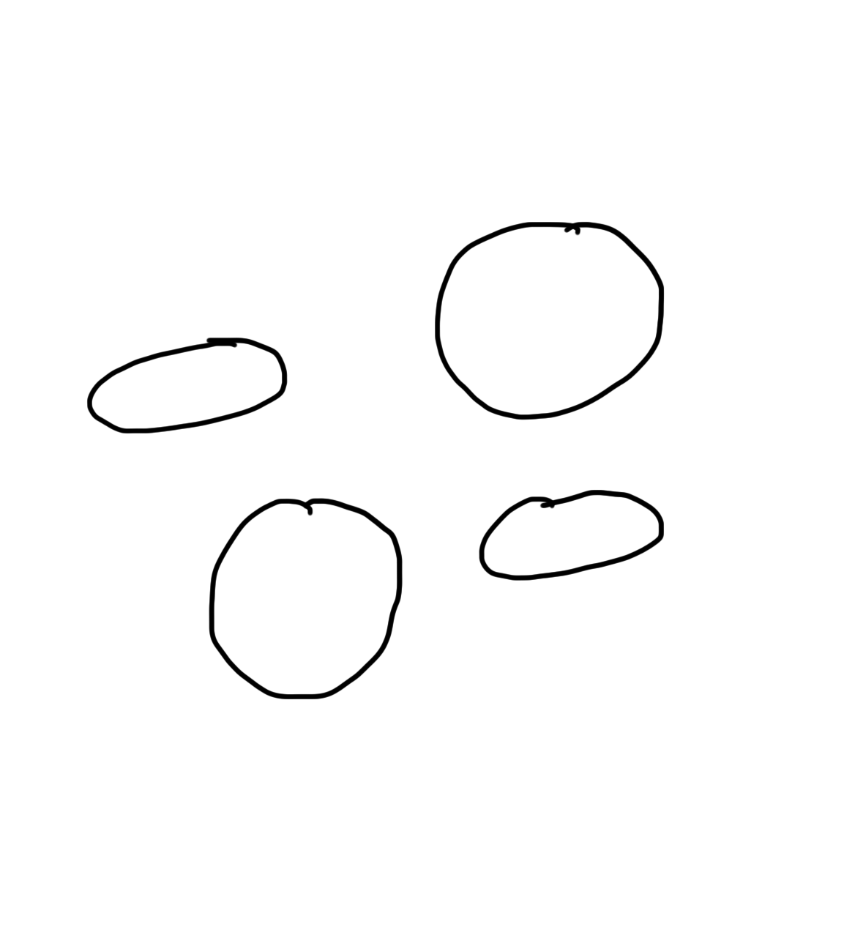
Narrow Intelligence
Translate
Turkish
Play Chess
Play Breakout
Drive a
Car

Slide 14
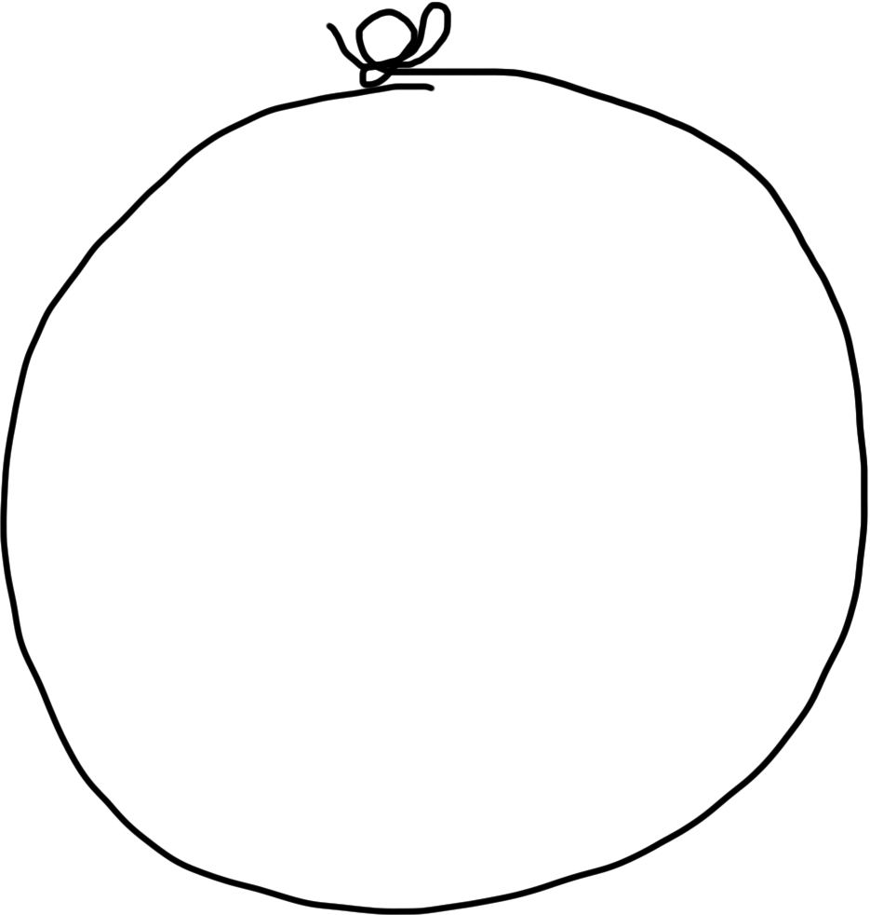
General Intelligence
Translate
Turkish
Play Chess
Play Breakout
Drive a
Car

Slide 15
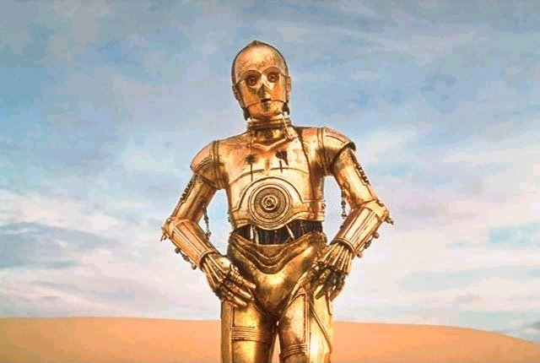
Brief History

Slide 16
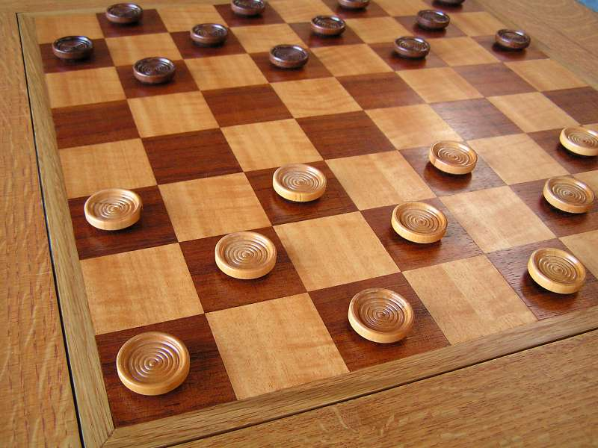
Early Optimism 1950s
1952

Slide 17
Early Optimism 1950s
“Machines will be capable, within twenty years, of doing any work a man can do.”
–Herbert Simon, 1952

Slide 18
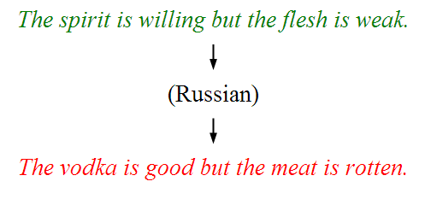
Underwhelming Results 1950s to 1980s
The world is too complex

Slide 19


Slide 20
Modern Game of AI
Non spoiler: this didn’t happen in game of thrones

Slide 21

Big Milestones

Slide 22

Told Speech Was 30 Years Out
Almost perfect…

Slide 23
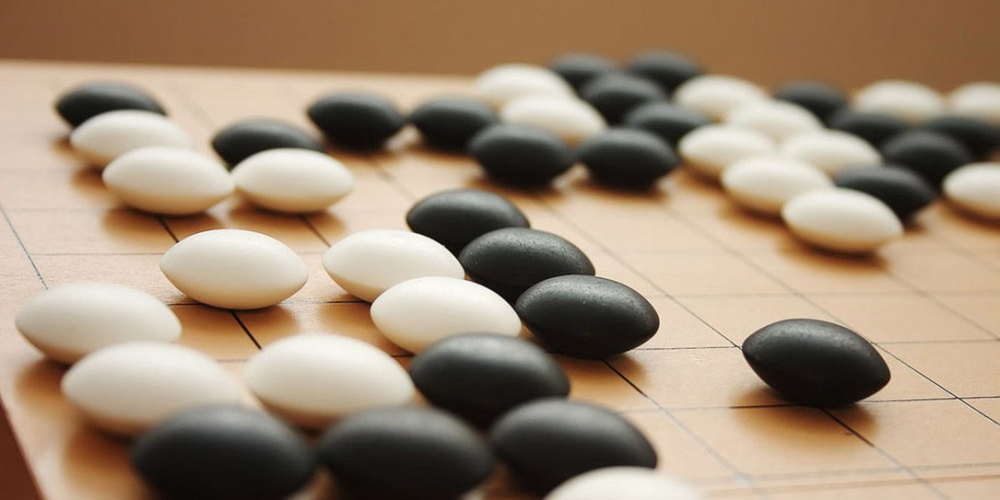
The Last Remaining Board Game

Slide 24
Computers Making Art

Slide 25
Self Driving Cars

Slide 26
What is going on?

Slide 27
[more suspense]

Slide 28
Story of Modern AI

Slide 29
Focus on one problem

Slide 30
Make a Harry Potter Sorting Hat

Slide 31

Classification
Logistic Regression is like the Harry Pottery Sorting Hat
That is a picture
of a one

Slide 32

Classification
Logistic Regression is like the Harry Pottery Sorting Hat
That is a picture
of a zero

Slide 33

Classification
That is a picture
of an zero
* It doesn’t have to be correct all of the time

Slide 34
Can you do it?

Slide 35

What number is this?

Slide 36

What number is this?

Slide 37

How about now?
What a computer sees
0 | 0 | 1 | 0 | 1 | 0 | 1 | 0 | 0 | 0 | 1 | 1 | 1 | 0 | 1
1 | 0 | 0 | 1 | 0 | 1 | 1 | 1 | 0 | 1 | 0 | 0 | 0 | 0 | 0
1 | 1 | 1 | 0 | 1 | 0 | 0 | 1 | 1 | 0 | 0 | 1 | 0 | 1 | 0
1 | 1 | 1 | 1 | 1 | 0 | 0 | 0 | 0 | 0 | 1 | 1 | 0 | 1 | 1
0 | 0 | 0 | 1 | 1 | 0 | 0 | 1 | 0 | 0 | 0 | 1 | 1 | 1 | 0
1 | 0 | 0 | 1 | 1 | 0 | 0 | 0 | 1 | 0 | 1 | 1 | 1 | 1 | 0
1 | 1 | 0 | 1 | 1 | 0 | 0 | 1 | 1 | 0 | 1 | 1 | 1 | 0 | 0
1 | 0 | 1 | 0 | 0 | 1 | 0 | 0 | 1 | 0 | 0 | 1 | 1 | 1 | 1
0 | 0 | 0 | 0 | 1 | 0 | 1 | 0 | 1 | 1 | 0 | 0 | 1 | 1 | 1
0 | 1 | 1 | 0 | 0 | 0 | 0 | 0 | 1 | 1 | 1 | 1 | 1 | 1 | 0
0 | 0 | 1 | 0 | 1 | 1 | 1 | 0 | 0 | 0 | 1 | 0 | 0 | 0 | 0
0 | 1 | 1 | 1 | 0 | 1 | 0 | 0 | 1 | 0 | 0 | 0 | 0 | 0 | 1
1 | 1 | 0 | 0 | 0 | 0 | 0 | 0 | 0 | 0 | 1 | 0 | 0 | 1 | 1
0 | 0 | 0 | 0 | 0 | 0 | 0 | 0 | 1 | 1 | 1 | 1 | 0 | 0 | 1
0 | 0 | 1 | 1 | 1 | 0 | 1 | 0 | 1 | 1 | 0 | 0 | 0 | 1 | 0
What a human sees

Slide 38
Why is it easy for Humans?
About 30% of your cortex is used from vision
3% is used to process hearing

Slide 39
Very hard to Program
??
public class HarryHat extends ConsoleProgram {
public void run() {
println(“Todo: Write program”);
}
}

Slide 40
Perhaps there is an insight?

Slide 41
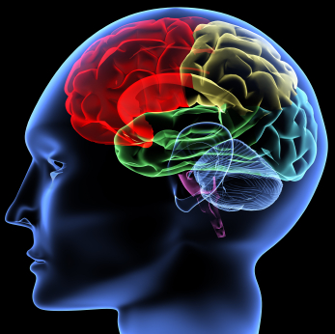
The hypothesis
One Algorithm Hypothesis
Much of perception in the brain can be explained with a single learning algorithm.
[Andrew Ng]

Slide 42

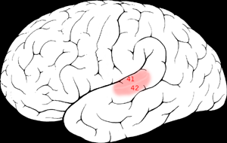

One Learning Algorithm
One Algorithm Hypothesis
Auditory Cortex
Auditory cortex learns to see
[Roe et al., 1992]
[Andrew Ng]

Slide 43
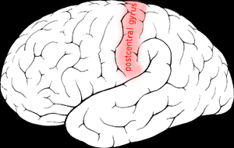

One Algorithm Hypothesis
Somatosensory Cortex
Somatosensory cortex learns to see
[Metin & Frost, 1989]
[Andrew Ng]

Slide 44
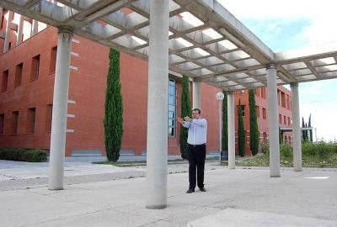
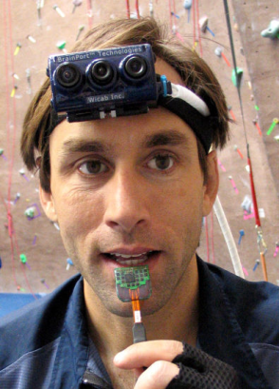
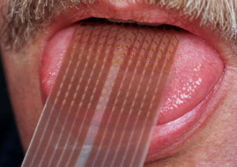
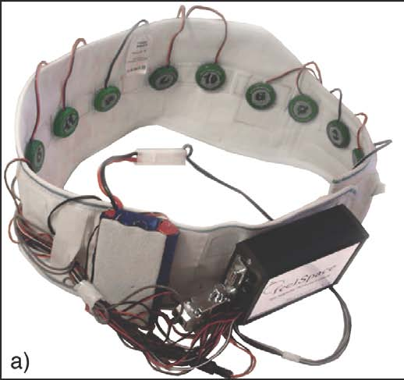
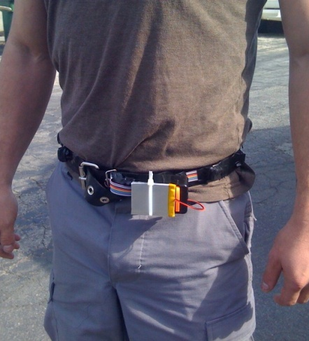
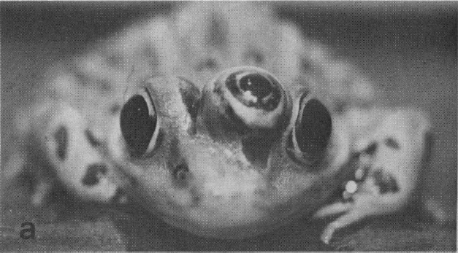
Sensor Representations
Seeing with your tongue
Human echolocation (sonar)
Haptic belt: Direction sense
Implanting a 3rd eye
[BrainPort; Welsh & Blasch, 1997; Nagel et al., 2005; Constantine-Paton & Law, 2009]

Slide 45
Two Great Ideas
1. Artificial Neurons
2. Learn by Example

Slide 46
Two Great Ideas
1. Artificial Neurons
2. Learn by Example

Slide 47
1. Artificial Neurons

Slide 48
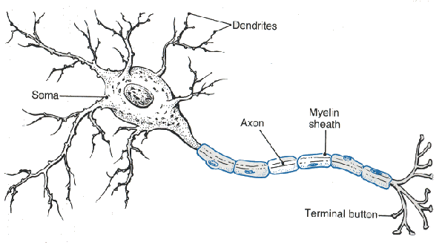
Neuron

Slide 49
Neuron

Slide 50
Neuron

Slide 51
Neuron

Slide 52
Neuron

Slide 53
Some Inputs are More Important

Slide 54
Artificial Neuron

Slide 55

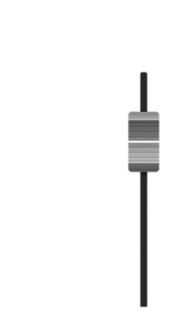

Inputs
+

Slide 56
Inputs
+

Slide 57
Inputs
+

Slide 58
Weights
+

Slide 59
Weights
+

Slide 60
Weights
+

Slide 61
Weighted Sum
+
double weightedSum = 0;
weightedSum = weightedSum + input0 * weight0;
weightedSum = weightedSum + input1 * weight1;
weightedSum = weightedSum + input2 * weight2;
weightedSum = weightedSum + input3 * weight3;

Slide 62
Filter and Output
+

Slide 63
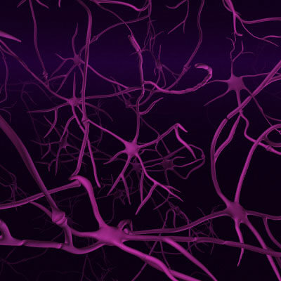
Biological Basis for Neural Networks
A neuron
Your brain
Actually, it’s probably someone else’s brain
???

Slide 64
Put Many Together
+
+
+
+

Slide 65
Put Many Together
Input Neurons
Hidden Neurons
Output Neurons

Slide 66
Making a Prediction
Input Neurons
Hidden Neurons
Output Neurons
…

Slide 67
Making a Prediction
Input Neurons
Hidden Neurons
Output Neurons
…

Slide 68
Making a Prediction
Input Neurons
Hidden Neurons
Output Neurons
…

Slide 69
Making a Prediction
Input Neurons
Hidden Neurons
Output Neurons
I think that is a picture of a one!
…

Slide 70
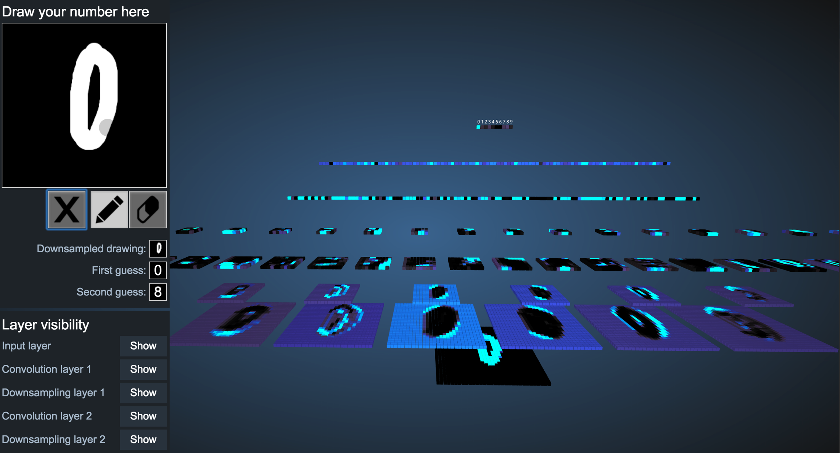
Demonstration
http://scs.ryerson.ca/~aharley/vis/conv/

Slide 71
Great Idea: Artificial Neurons

Slide 72
Two Great Ideas
1. Artificial Neurons
2. Learn by Example

Slide 73
Two Great Ideas
1. Artificial Neurons
2. Learn by Example

Slide 74
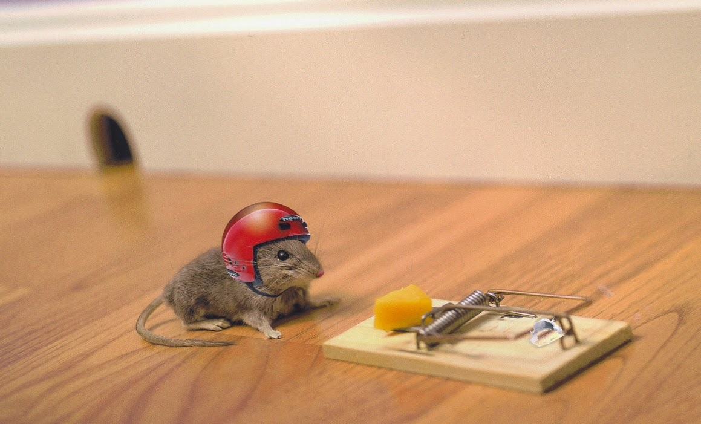
2. Learn From Experience

Slide 75
Neural Networks gets their intelligence from its sliders (aka its parameters)

Slide 76
Neural Network
Input Neurons
Hidden Neurons
Output Neurons

Slide 77
Neural Network
+
+
+
+

Slide 78

Learn by Example

Slide 79
+

Slide 80
+

Slide 81
I think that is a picture of a One!
+
What do you mean it’s actually a Zero?
I’ll adjust my sliders so that I do a better job in the future

Slide 82
I think that is a picture of a One!
+
What do you mean it’s actually a Zero?
I’ll adjust my sliders so that I do a better job in the future

Slide 83
+

Slide 84
+

Slide 85
+

Slide 86
I think that is a picture of a One!
+
Wahoo I got it right!

Slide 87
+

Slide 88
+

Slide 89
I think that is a picture of a zero!
+
What do you mean it’s actually a one?
I’ll adjust my sliders so that I do a better job in the future

Slide 90
I think that is a picture of a zero!
+
What do you mean it’s actually a one?
I’ll adjust my sliders so that I do a better job in the future

Slide 91
Study Hard!

Slide 92
Train on Faces

Slide 93
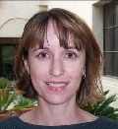
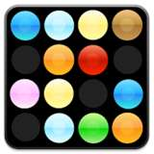
Visualize the Sliders
object models
object parts
(combination
of edges)
Training set: Aligned
images of faces.
edges
pixels
[Honglak Lee]

Slide 94
Woah… that’s like a brain…

Slide 95
True.

Slide 96
Decomposition
Mountain Karel
Climb Up Mountain
Step Up
Pick Beeper
Climb Down Mountain
Step Down
Notes:
He looks like an old machintosh machine.
Hes got legs… one sticks out the back. That’s just the way it is.

Slide 97
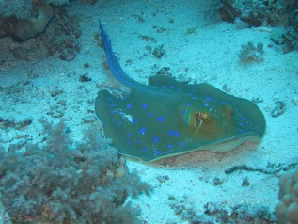
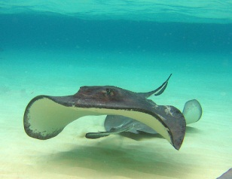
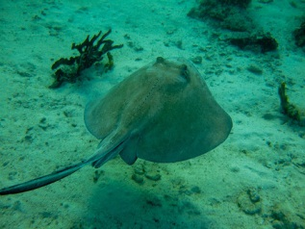
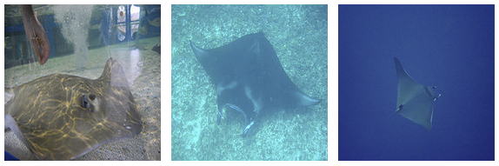
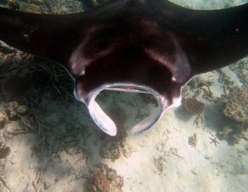
Image Net Classification
…
smoothhound, smoothhound shark, Mustelus mustelus
American smooth dogfish, Mustelus canis
Florida smoothhound, Mustelus norrisi
whitetip shark, reef whitetip shark, Triaenodon obseus
Atlantic spiny dogfish, Squalus acanthias
Pacific spiny dogfish, Squalus suckleyi
hammerhead, hammerhead shark
smooth hammerhead, Sphyrna zygaena
smalleye hammerhead, Sphyrna tudes
shovelhead, bonnethead, bonnet shark, Sphyrna tiburo
angel shark, angelfish, Squatina squatina, monkfish
electric ray, crampfish, numbfish, torpedo
smalltooth sawfish, Pristis pectinatus
guitarfish
roughtail stingray, Dasyatis centroura
butterfly ray
eagle ray
spotted eagle ray, spotted ray, Aetobatus narinari
cownose ray, cow-nosed ray, Rhinoptera bonasus
manta, manta ray, devilfish
Atlantic manta, Manta birostris
devil ray, Mobula hypostoma
grey skate, gray skate, Raja batis
little skate, Raja erinacea
…
Stingray
Mantaray

Slide 98
0.005%
1.5%
?
Random guess
Pre Neural Networks
GoogLeNet
Le, et al., Building high-level features using large-scale unsupervised learning. ICML 2012

Slide 99
0.005%
1.5%
43.9%
Random guess
Pre Neural Networks
GoogLeNet
Szegedy et al, Going Deeper With Convolutions, CVPR 2015

Slide 100
0.005%
1.5%
66.3%
Random guess
Pre Neural Networks
2016
http://image-net.org/challenges/LSVRC/2016/results

Slide 101

Google Brain

Slide 102
Google Brain
1 Trillion Artificial Neurons

Slide 103
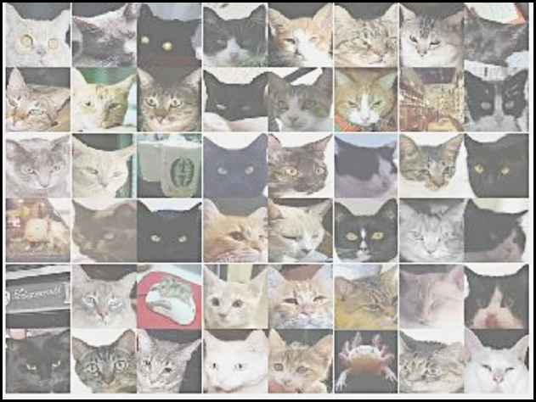
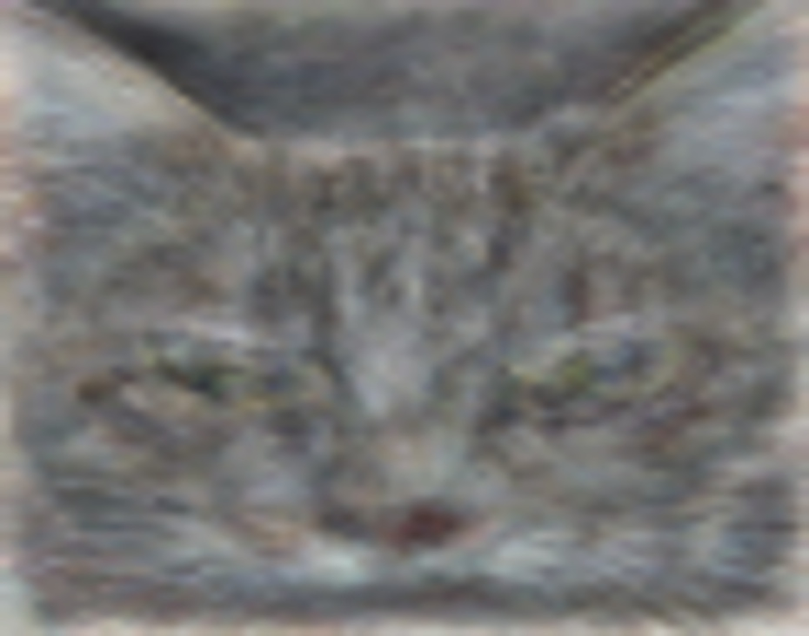
A Neuron That Fires When It Sees Cats
Top stimuli from the test set
Optimal stimulus
by numerical optimization
Le, et al., Building high-level features using large-scale unsupervised learning. ICML 2012

Slide 105
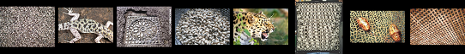
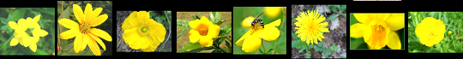

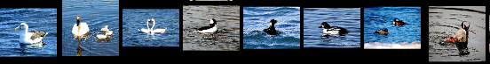

Other Neurons
Neuron 1
Neuron 2
Neuron 3
Neuron 4
Neuron 5
Le, et al., Building high-level features using large-scale unsupervised learning. ICML 2012
Input to another layer above
(image with 8 channels)
Number of output
channels = 8
LCN Size = 5
H
Pooling Size = 5
Number
of maps = 8
One layer
W
RF size = 18
Number of input
channels = 3
Image Size = 200

Slide 106
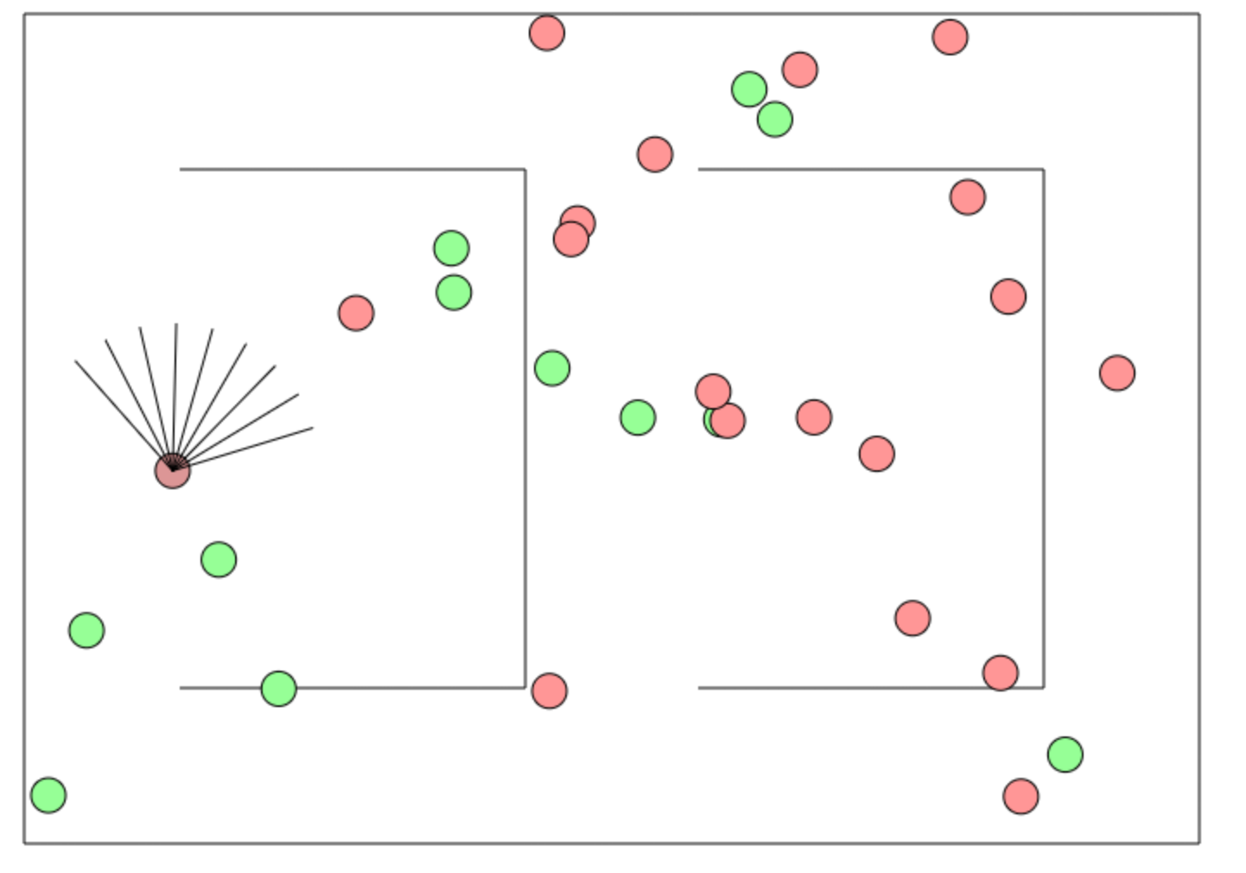
Beyond Harry Potter Hats
http://cs.stanford.edu/people/karpathy/convnetjs/demo/rldemo.html

Slide 107
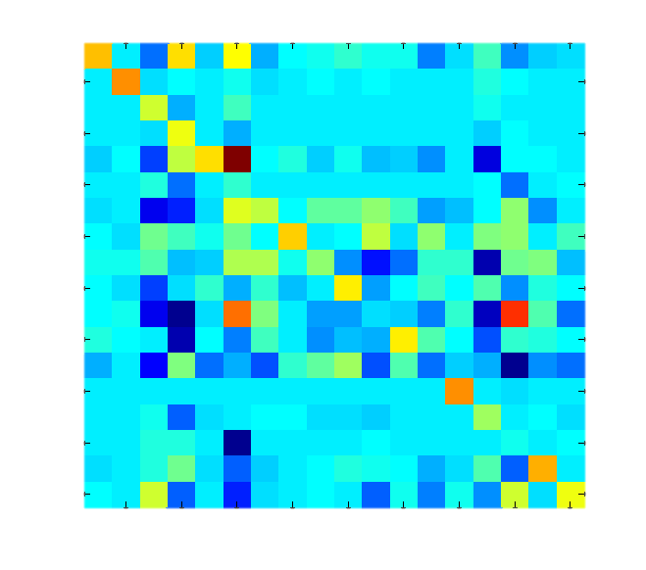
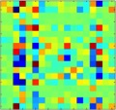
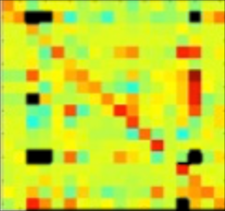
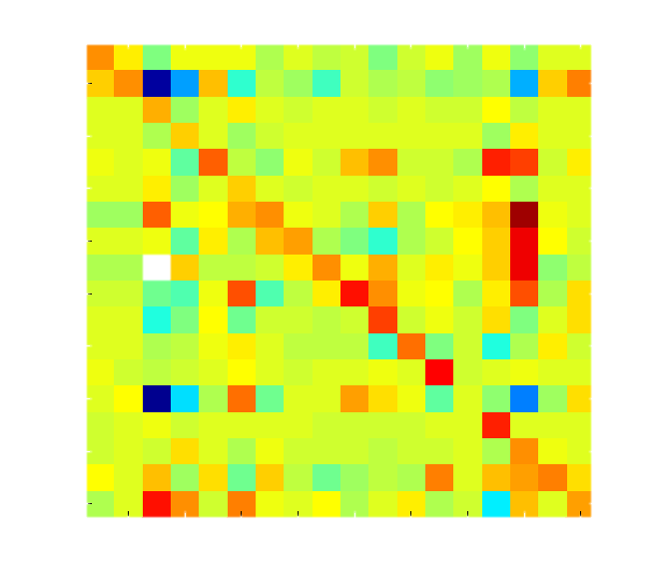
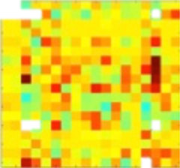
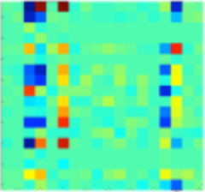

Helping Students Learn to Program
It looks like you have a fencepost error!
// User defined method
private void run() {
while(isClear()){
putBeeper();
move();
}
putBeeper();
}
run
while
putBeeper
cond
body
putBeeper
move

Slide 108
The Current Challenge
Stanford Breakout
9,542 historical submissions (with grades)
Each year we spend about 1,000 teacher hours grading

Slide 109
The Future of AI
Human Intelligence
Performance
Complex Programs
Neural Networks
Time
Now
2012
Notes:
NVIDIA or ATI will be future of AI. Probably NVIDIA.

Slide 110
The Future of AI
Human Intelligence
Performance
Complex Programs
Neural Networks
Time
Now
2012
Notes:
NVIDIA or ATI will be future of AI. Probably NVIDIA.

Slide 111
The Future of AI
Human Intelligence
Performance
Complex Programs
Neural Networks
Time
Now
2012
Notes:
NVIDIA or ATI will be future of AI. Probably NVIDIA.

Slide 112
The Future of AI
Einstein
Human Intelligence
Performance
Complex Programs
Neural Networks
Time
Now
2012
Notes:
NVIDIA or ATI will be future of AI. Probably NVIDIA.

Slide 113
Open Problems?

Slide 114
Machine Learning Uses a Lot of Data

Slide 115
One Shot Learning
Single training example:
Test set:

Slide 116
One Shot Learning
Single
training
example:

Slide 117
Where is my robot?

Slide 118
… coming soon

Slide 119

Know It So You Can Beat It
Little math

Slide 120
Can you do it?

Slide 121
I explained to you the main components

Slide 122
Not easy…

Slide 123
But yes. You can.

Slide 124

Path to AI

Slide 125
Next Step:
…

Slide 126
Why?

Slide 127

Closest Thing To Magic

Slide 128
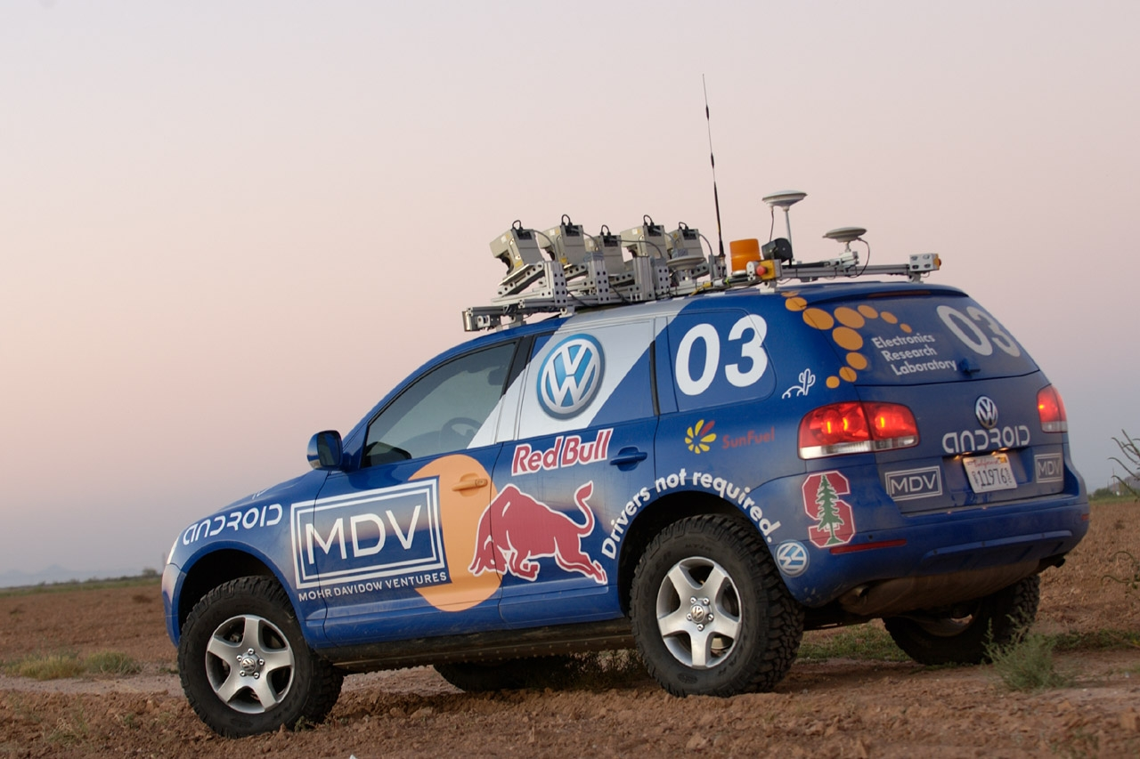
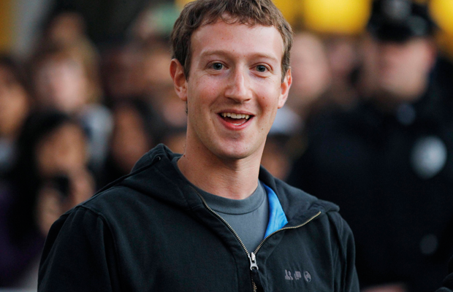
Now is the Time

Slide 129
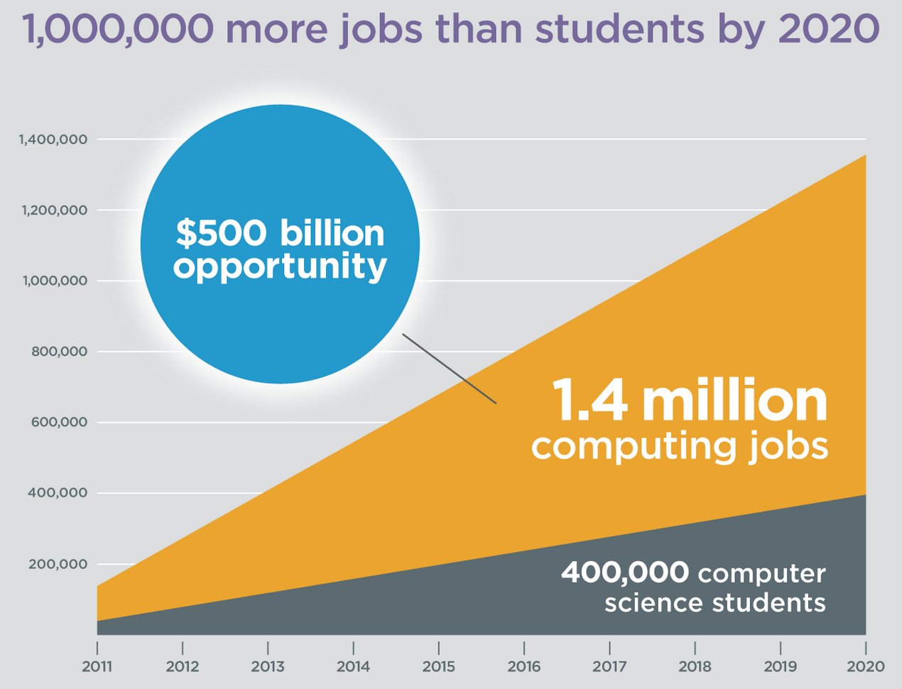
Oh and Its Useful
Code.org

Slide 130
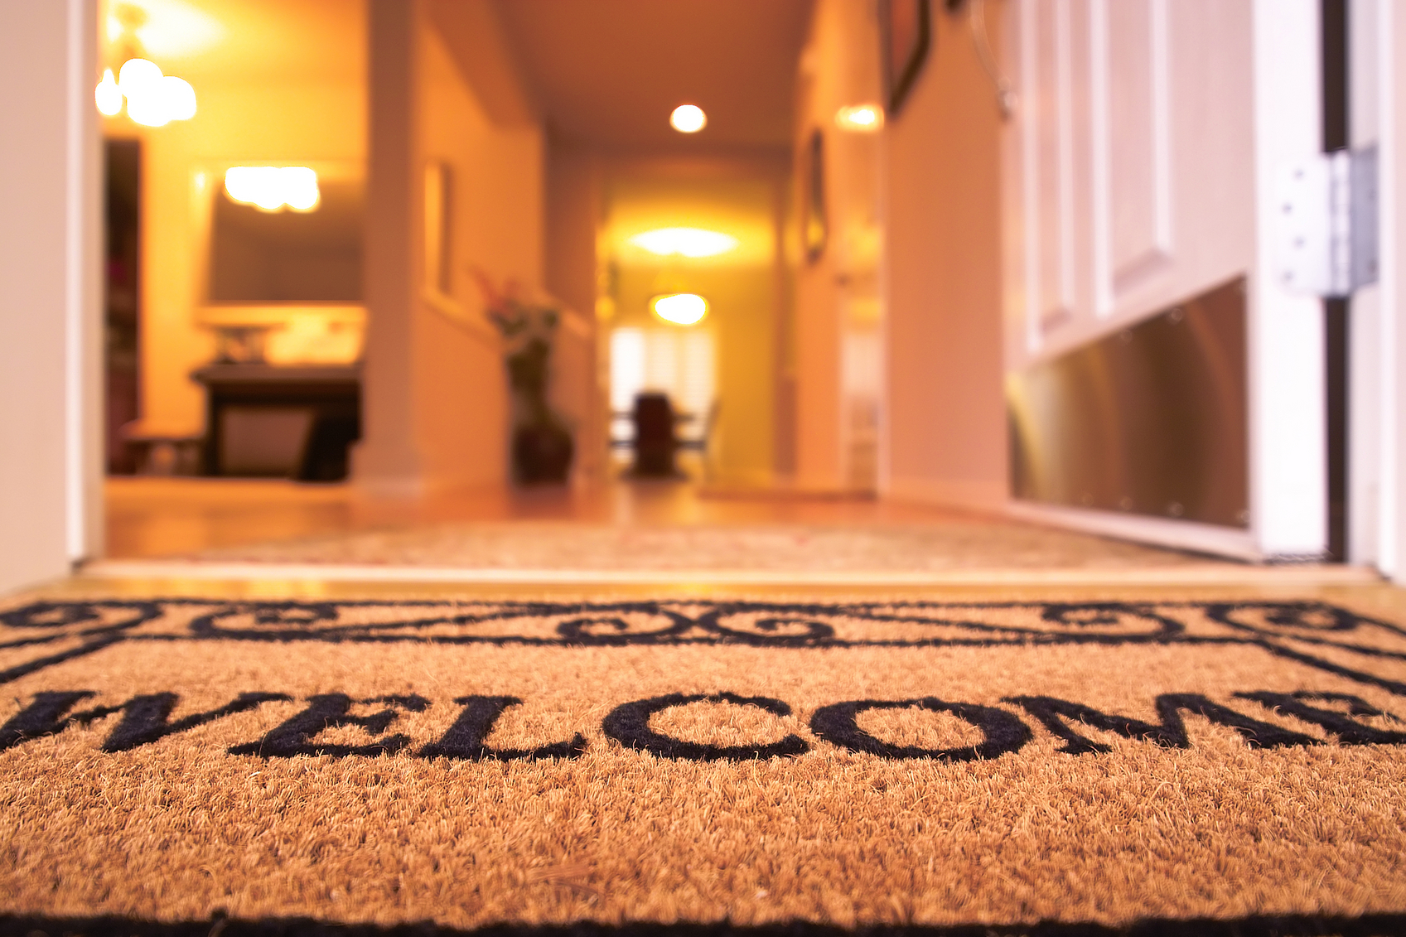
Everyone is Welcome

Slide 131
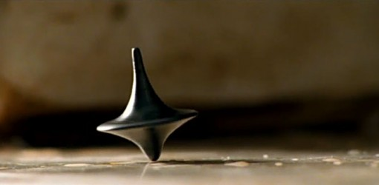
The End?

